Slide 1
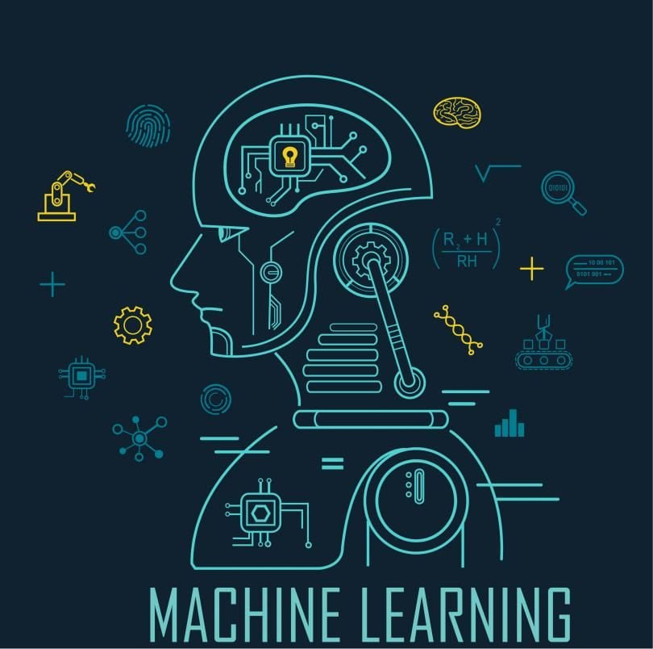
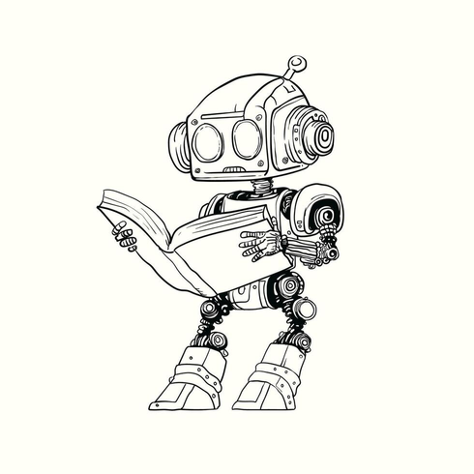
MACHINE LEARNING
TRAINING ON MACHINE LEARNING WITH PYTHON
Mentor : Gagan Rajput

Slide 2

Contents
1
Introduction to machine learning
2
Difference between AI, ML, DL and DS
3
Application of machine learning
4
Types of machine learning
5
Life cycle of machine learning

Slide 3
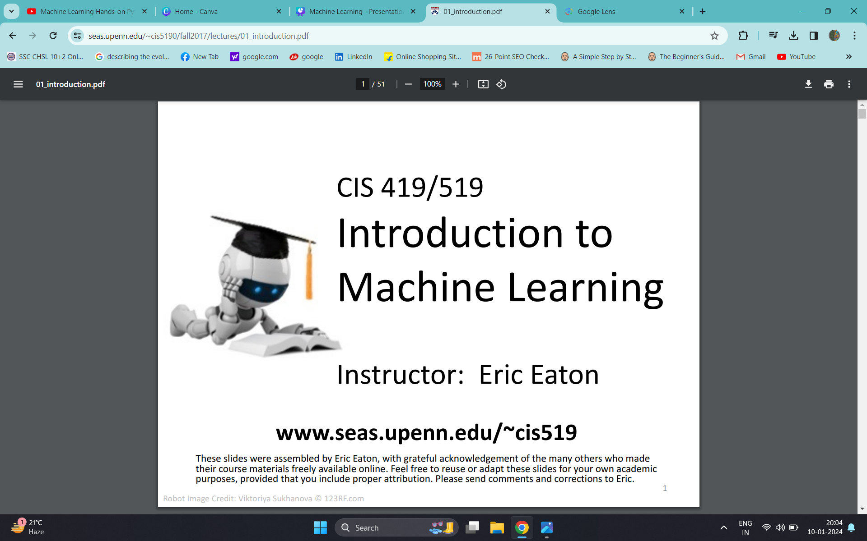
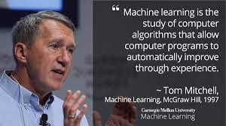
Introduction to Machine Learning
"Machine Learning is a branch of artificial intelligence (AI) that enables machines to learn and improve from experience without being explicitly programmed."
The name machine learning was coined in 1959 by Arthur Samuel Tom M. Mitchell provided a widely quoted, more formal definition of the algorithms studied in the machine learning field
Definition by Tom Mitchell (1998):
Machine Learning is the study of algorithms that
• improve their performance P
• at some task T
• with experience E.
A well-defined learning task is given by <P, T, E>

Slide 4
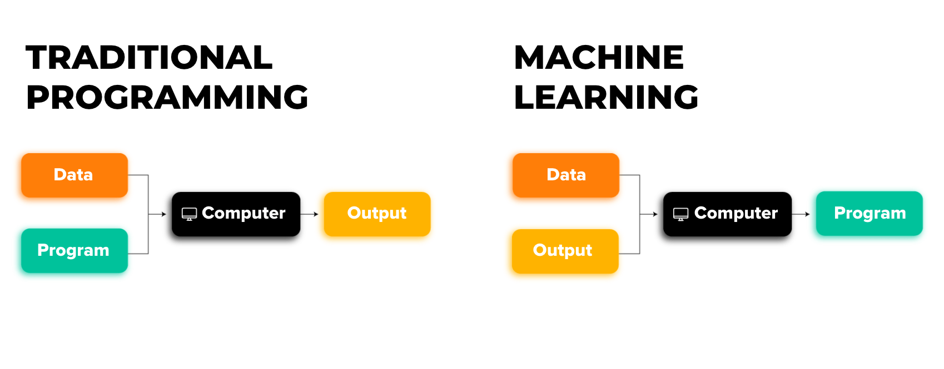

Slide 5
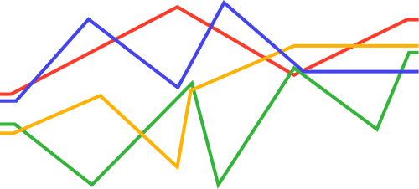
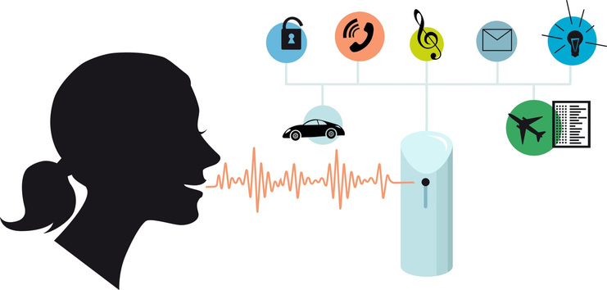


Why Machine Learning is Important
Human expertise does not exist (navigating on Mars)
Some tasks cannot be defined well, except by examples (e.g., recognizing people)
Relationships and correlations can be hidden within large amounts of data. Machine Learning/Data Mining may be able to find these relationships.
Humans can’t explain their expertise (speech recognition)

Slide 6
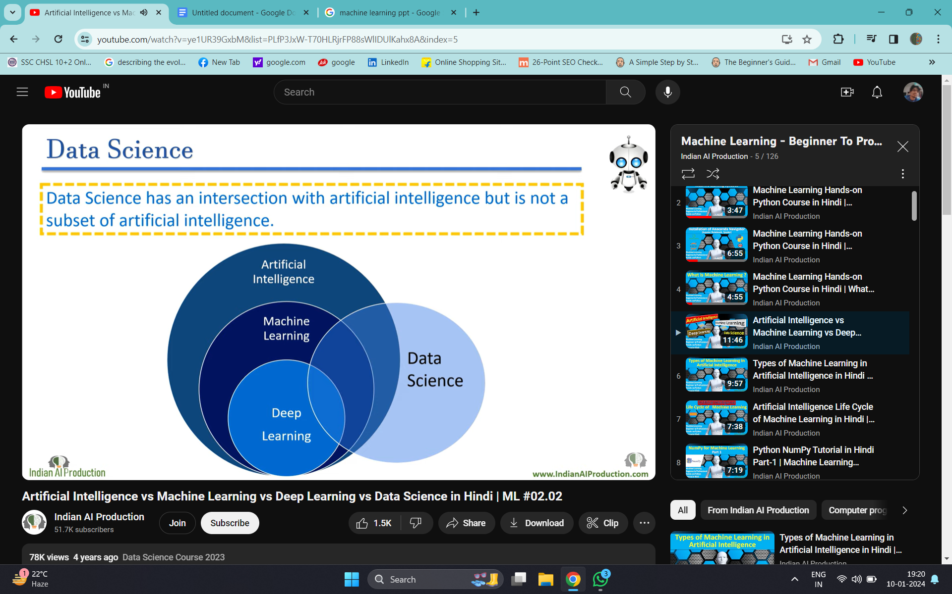
Difference between AI, ML, DL and DS

Slide 7
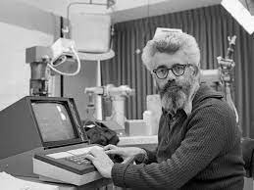
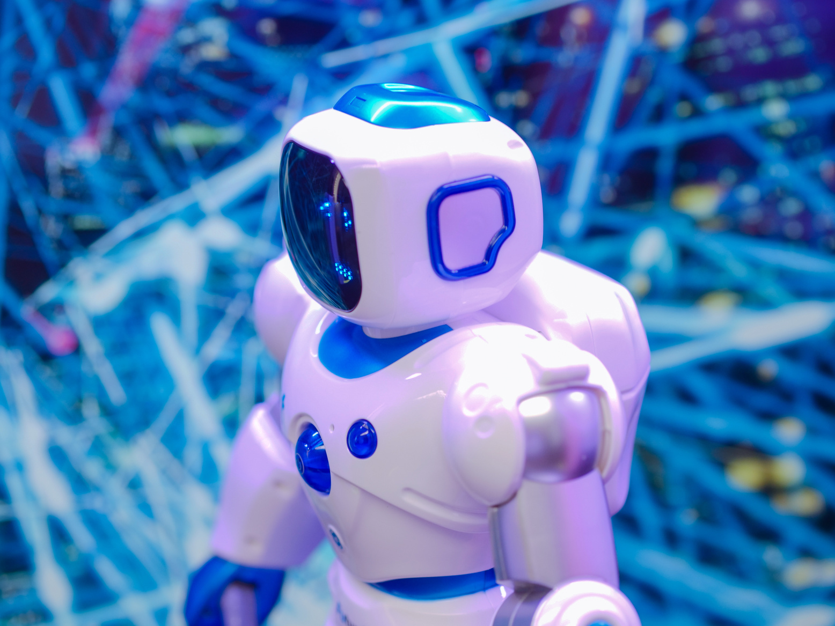
Artificial Intelligence
Al(Artificial Intelligence) is a subfield of Computer Science.
John McCarthy in year 1956s
Al term was coined by John McCarthy in year 1956s
Artificial Intelligence, term was meant to describe the goal that machines will be able to have humans like intelligence in future

Slide 8


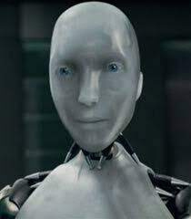
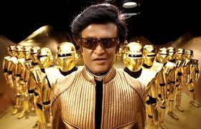
types of Artificial Intelligence
Artificial Intelligence can be split between two branches:
1.Applied Al(weak Al)
2.Generalized Al (strong Al
1. Applied Al(weak AI)- perform some specific tasks.
2.Generalized Al(strong Al)- acts like humans.

Slide 9
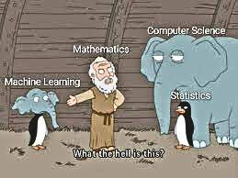
Machine Learning
Machine Learning is a subset of Al.
Machine Learning is a set of algorithms that train on a data set to make predictions or take actions in order to optimize some systems.

Slide 10
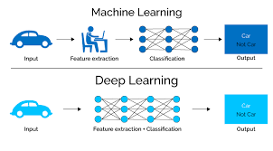
Deep Learning
Deep Learning is a next evolution of machine learning.
The term Deep Learning was introduced to the machine learning community in 1986
Deep Learning is a subset of Machine Learning Where learning method is based on data representation or feature learning.
Deep Learning example : Google Lens, Camera Filters etc

Slide 11
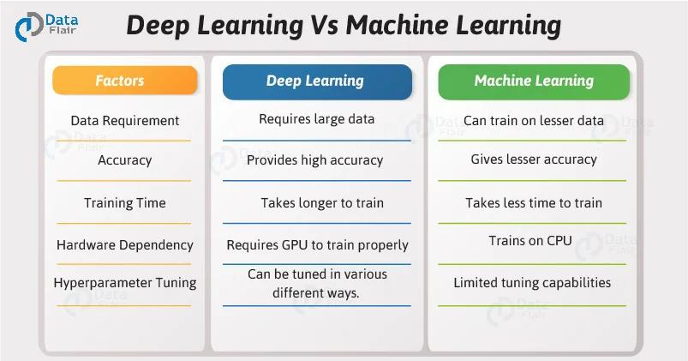

Slide 12
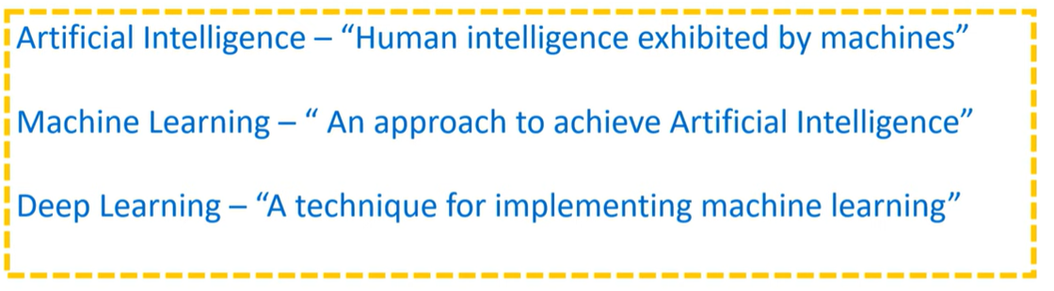

Slide 13
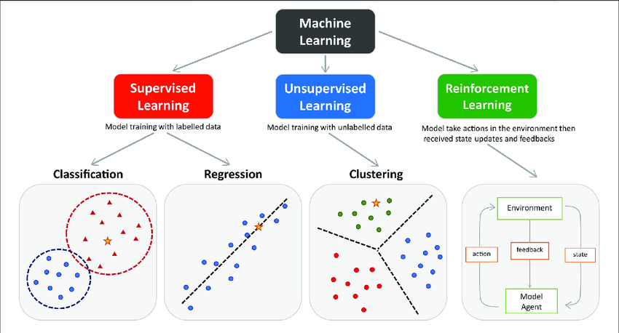
Types of Machine Learning

Slide 14
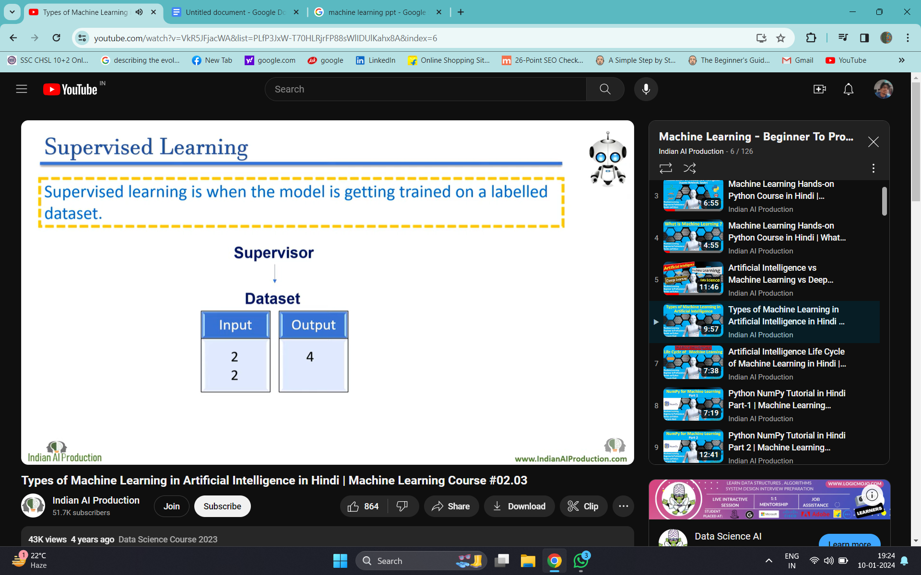
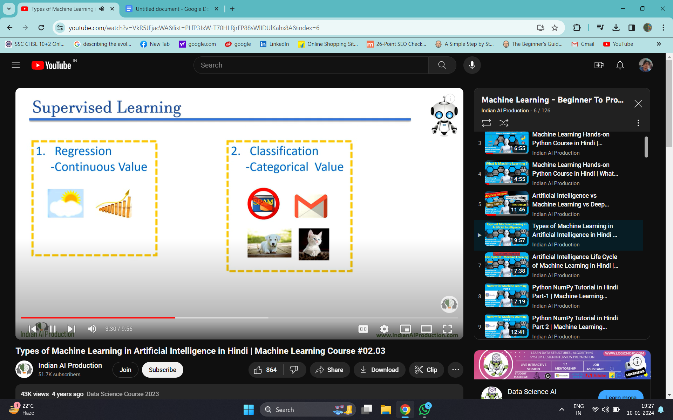
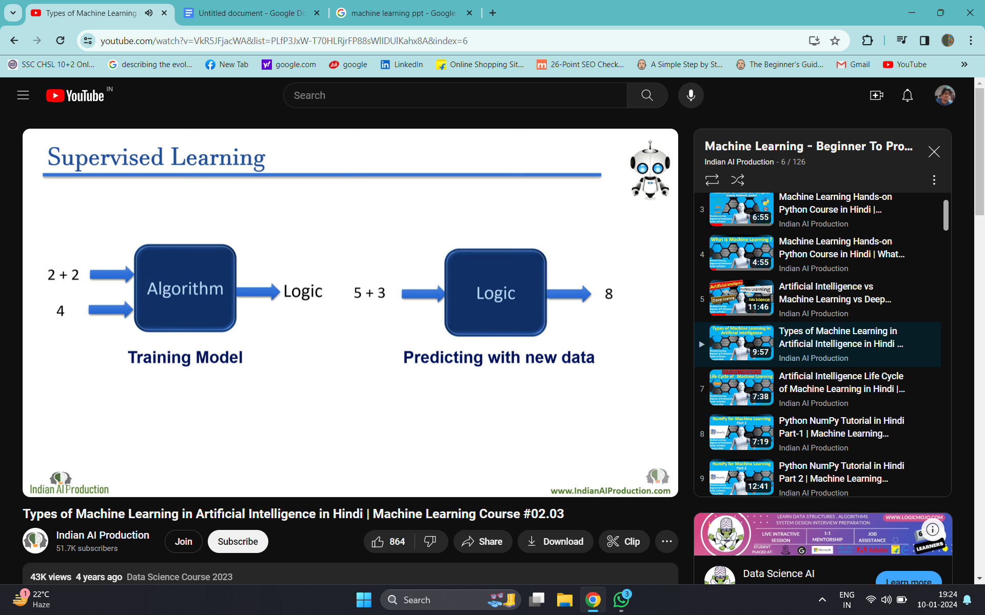

Slide 15
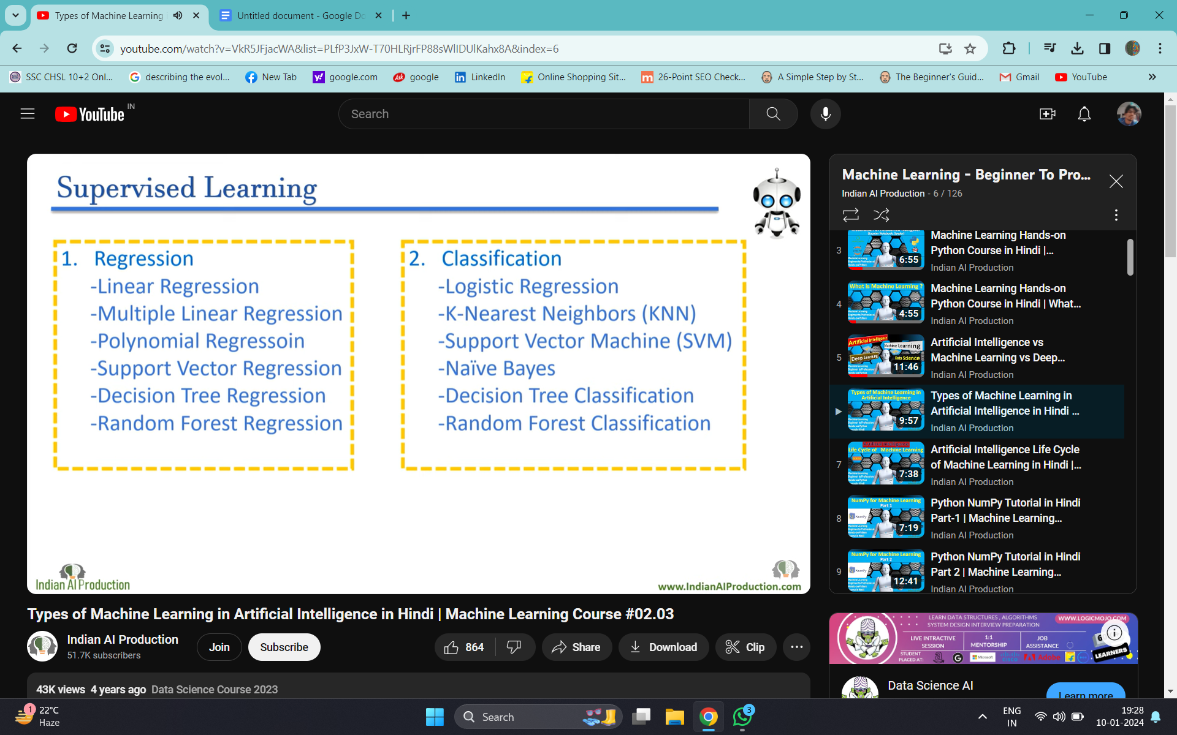

Slide 16
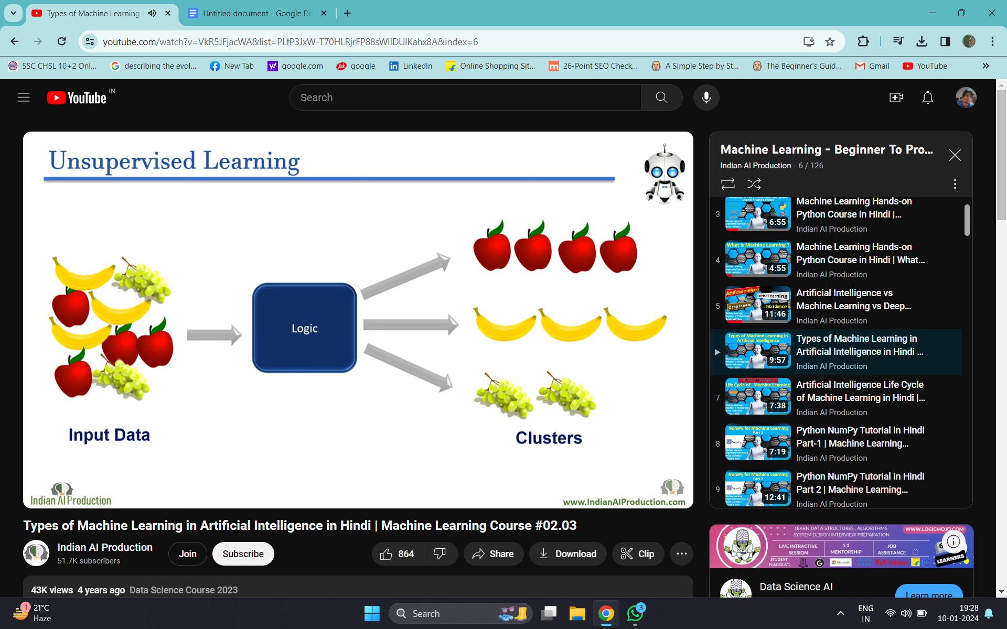
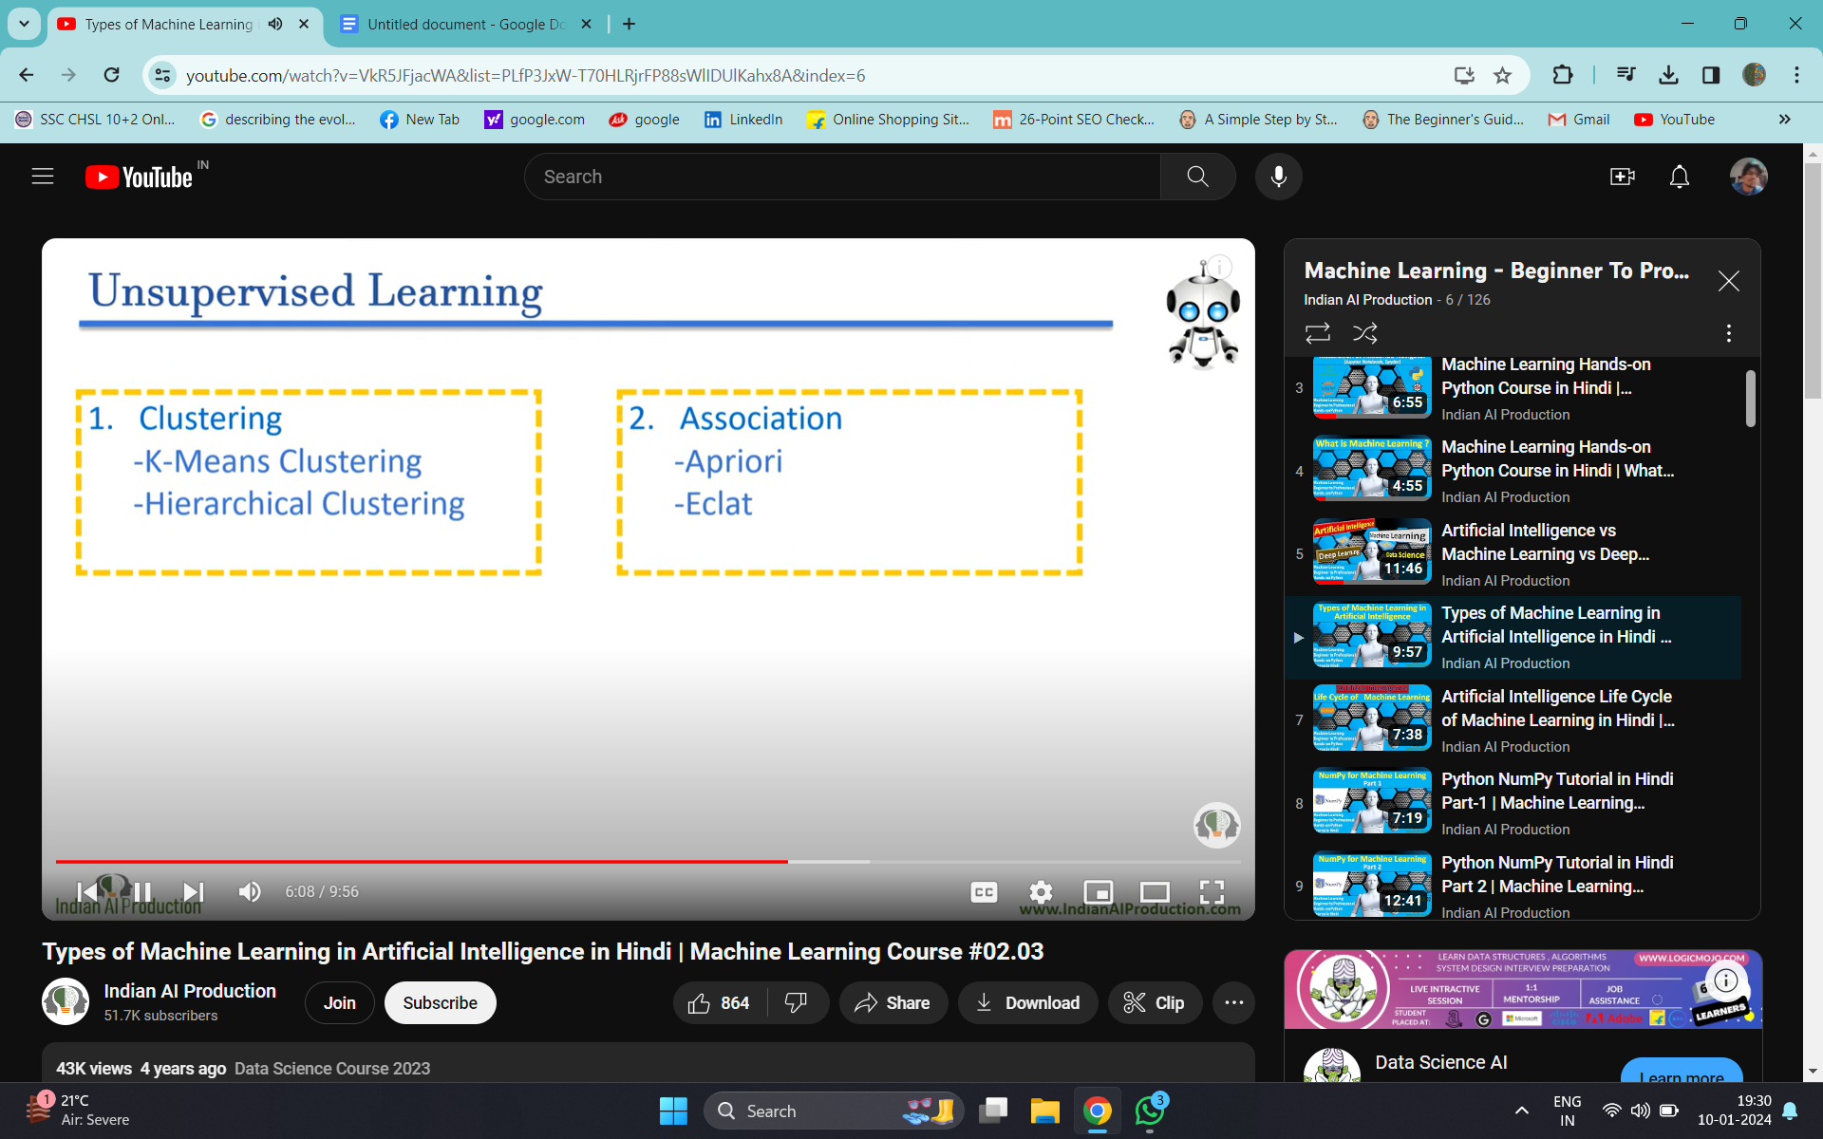

Slide 17
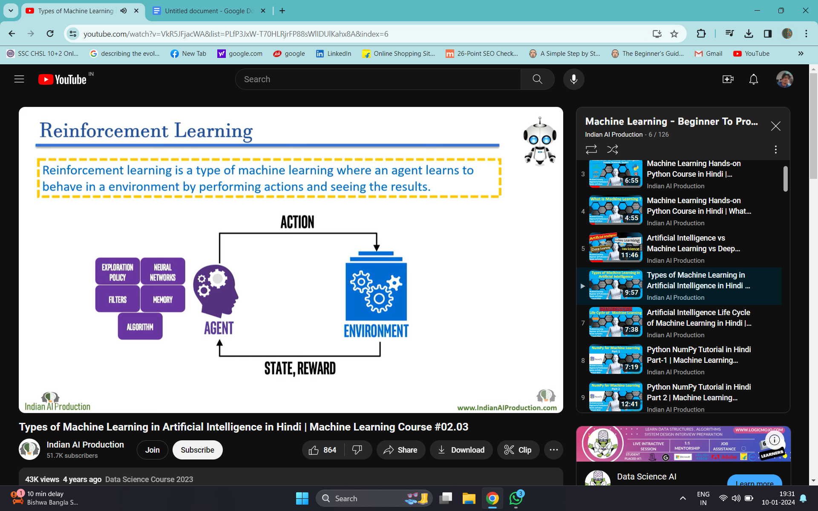
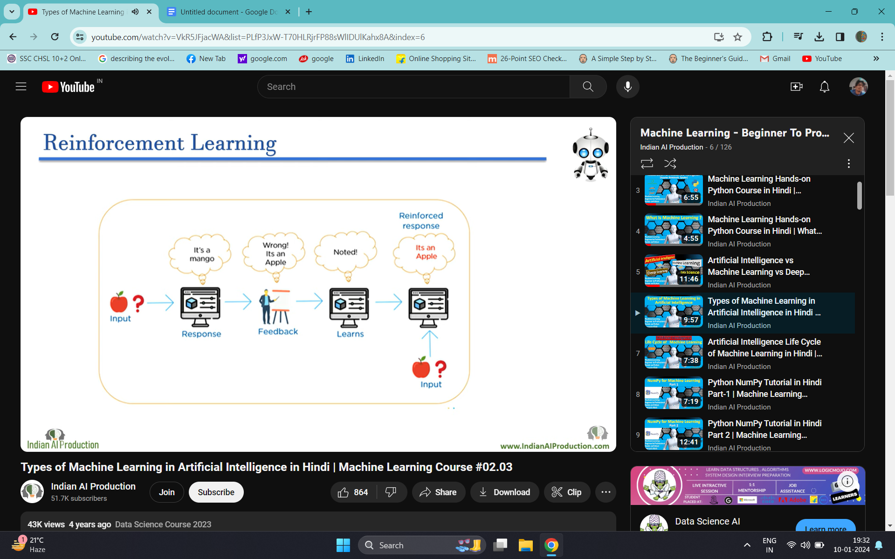

Slide 18
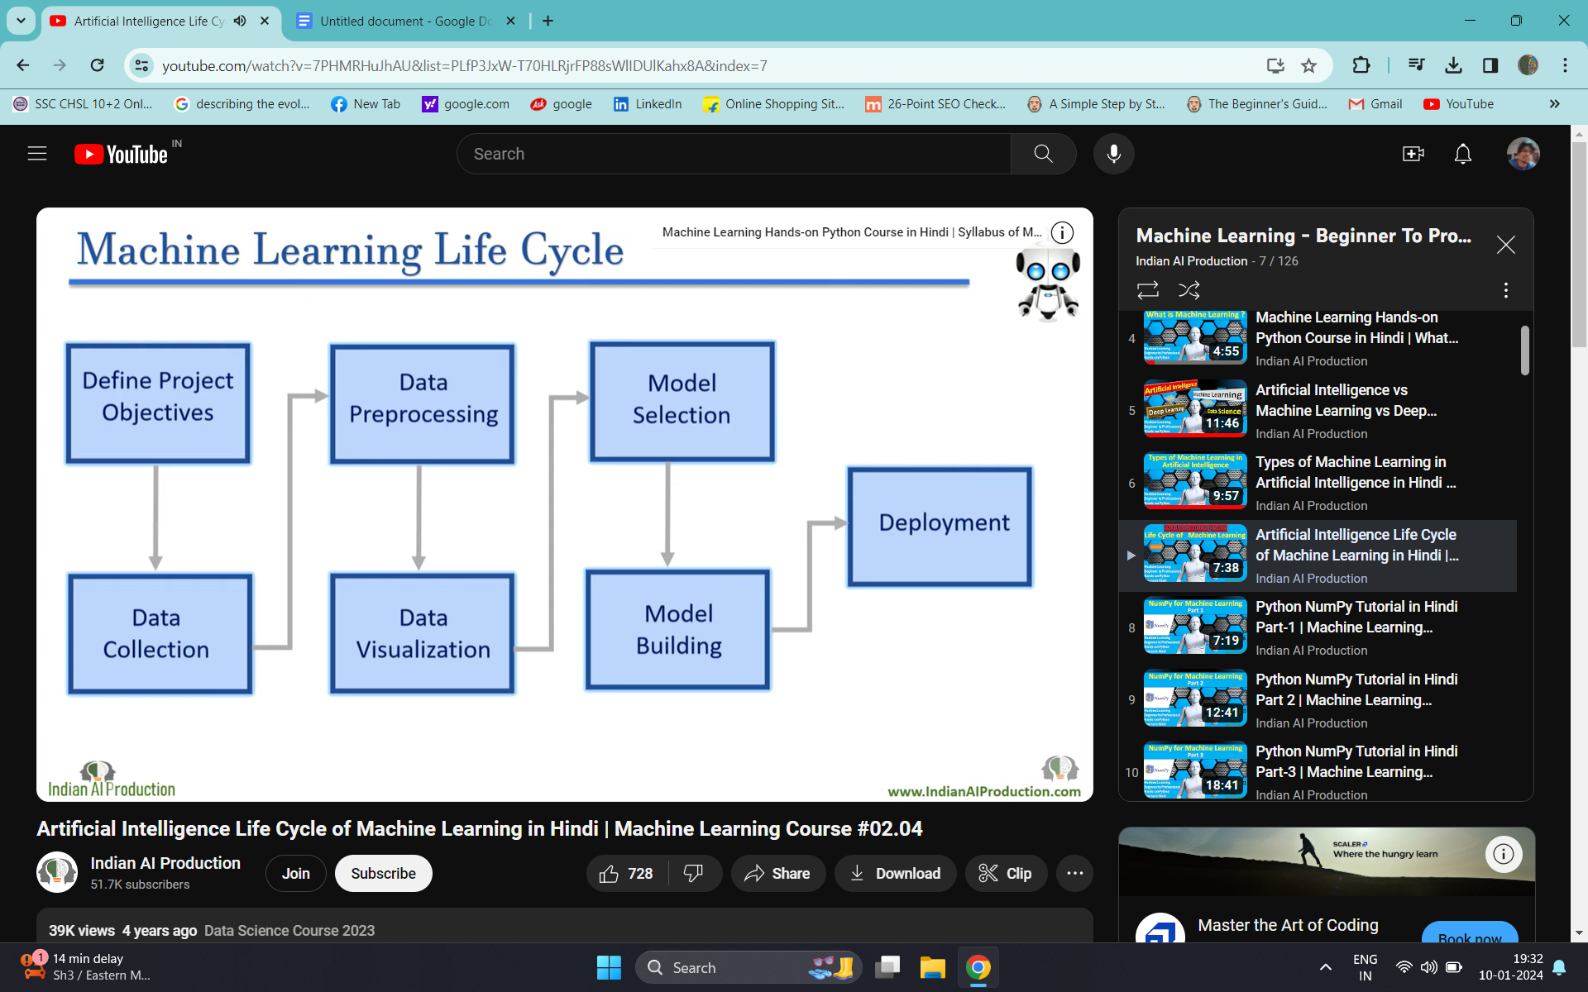

Slide 19
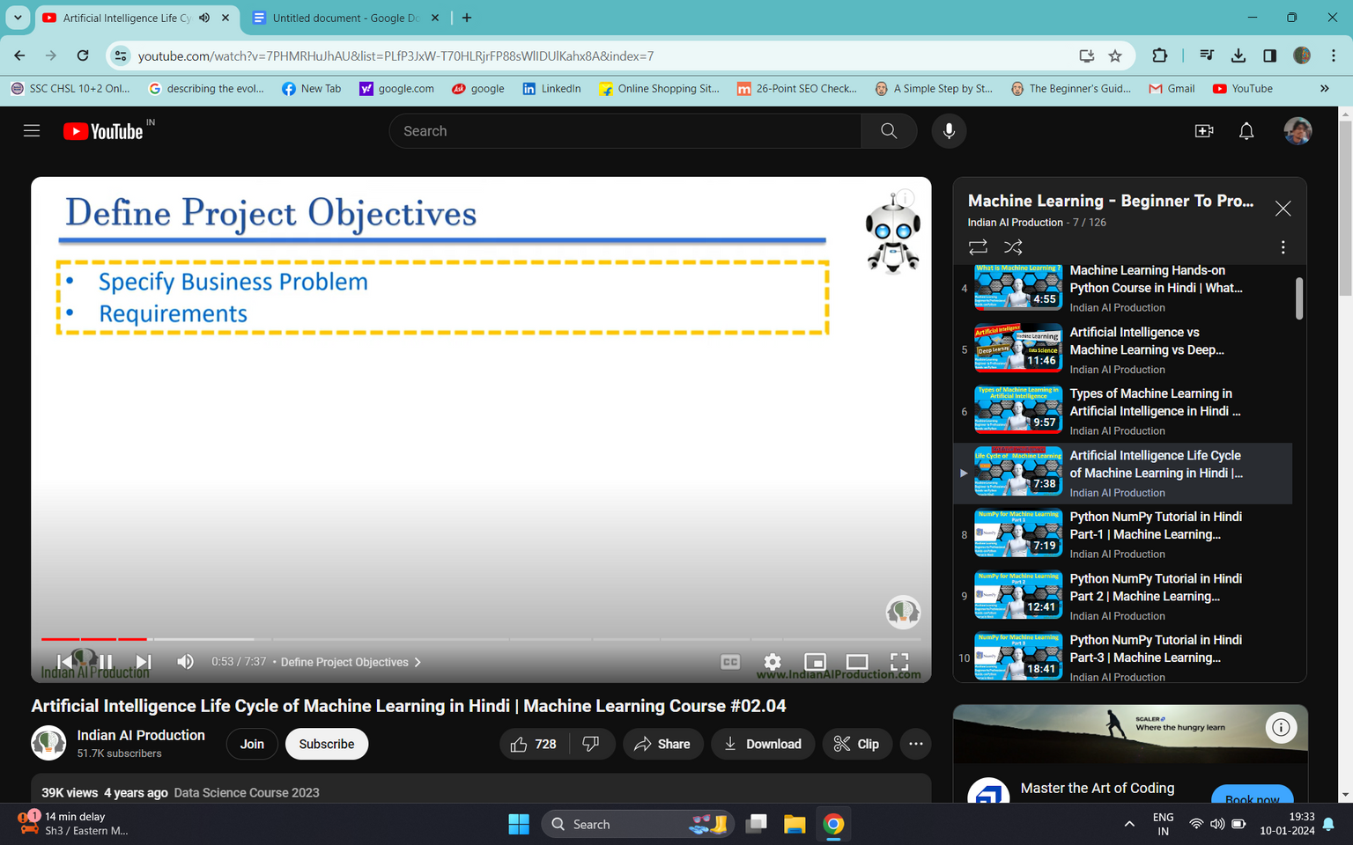
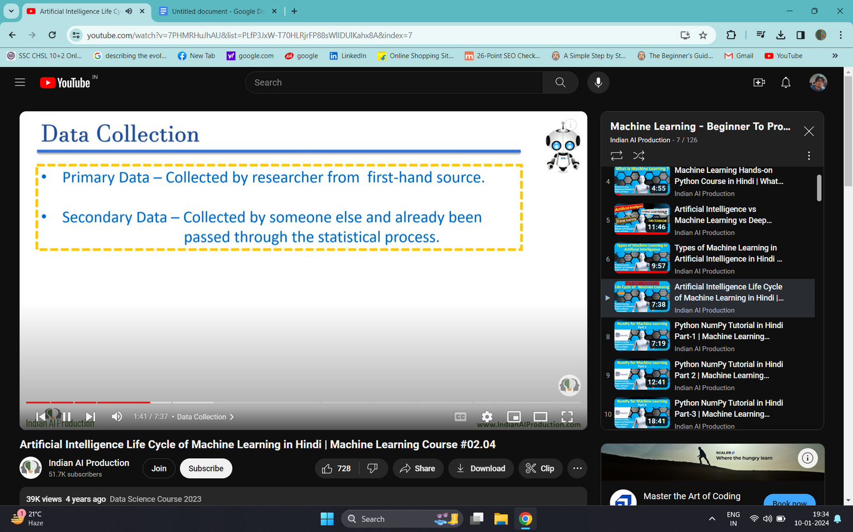

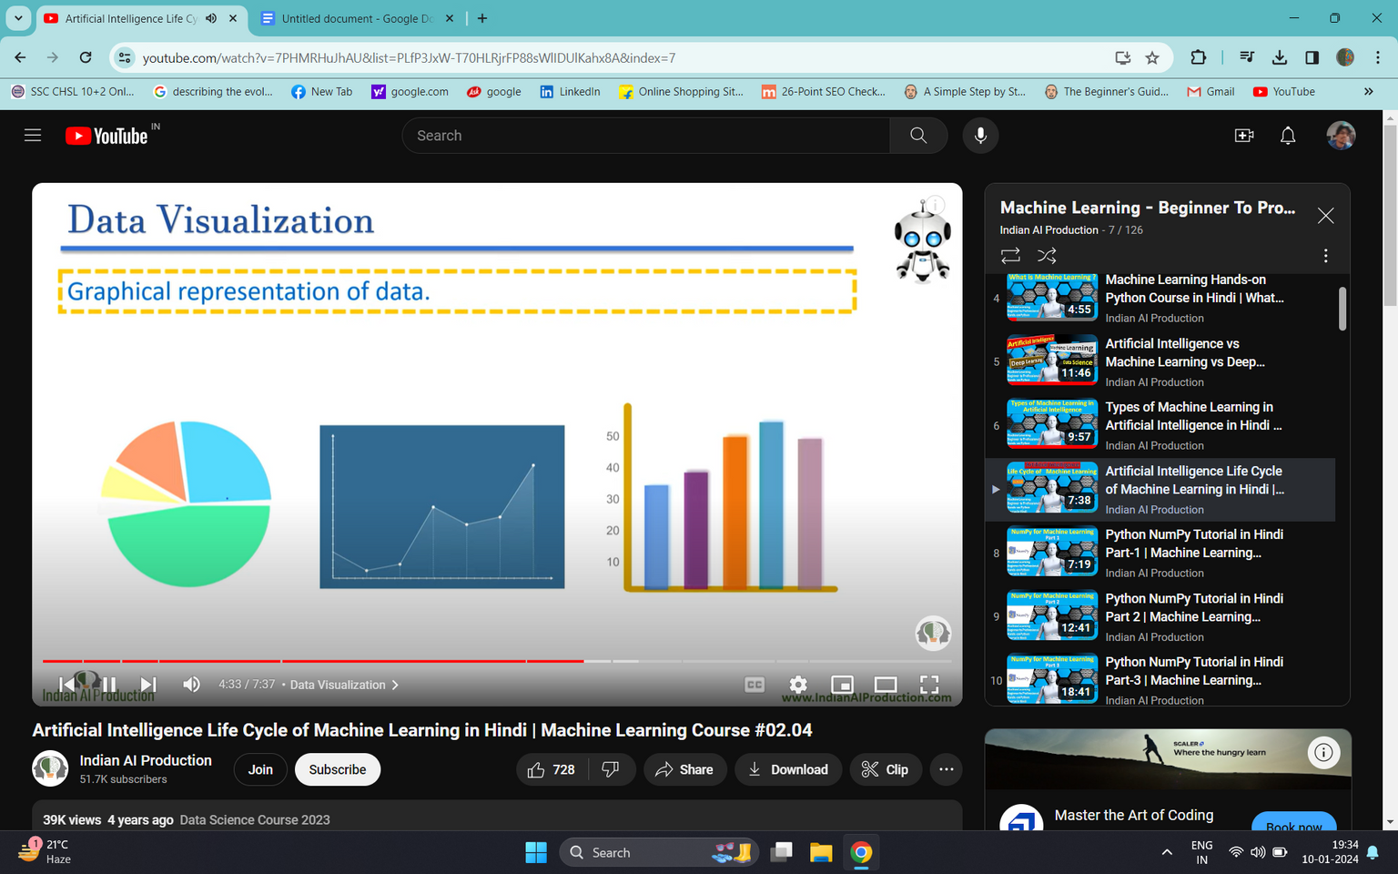
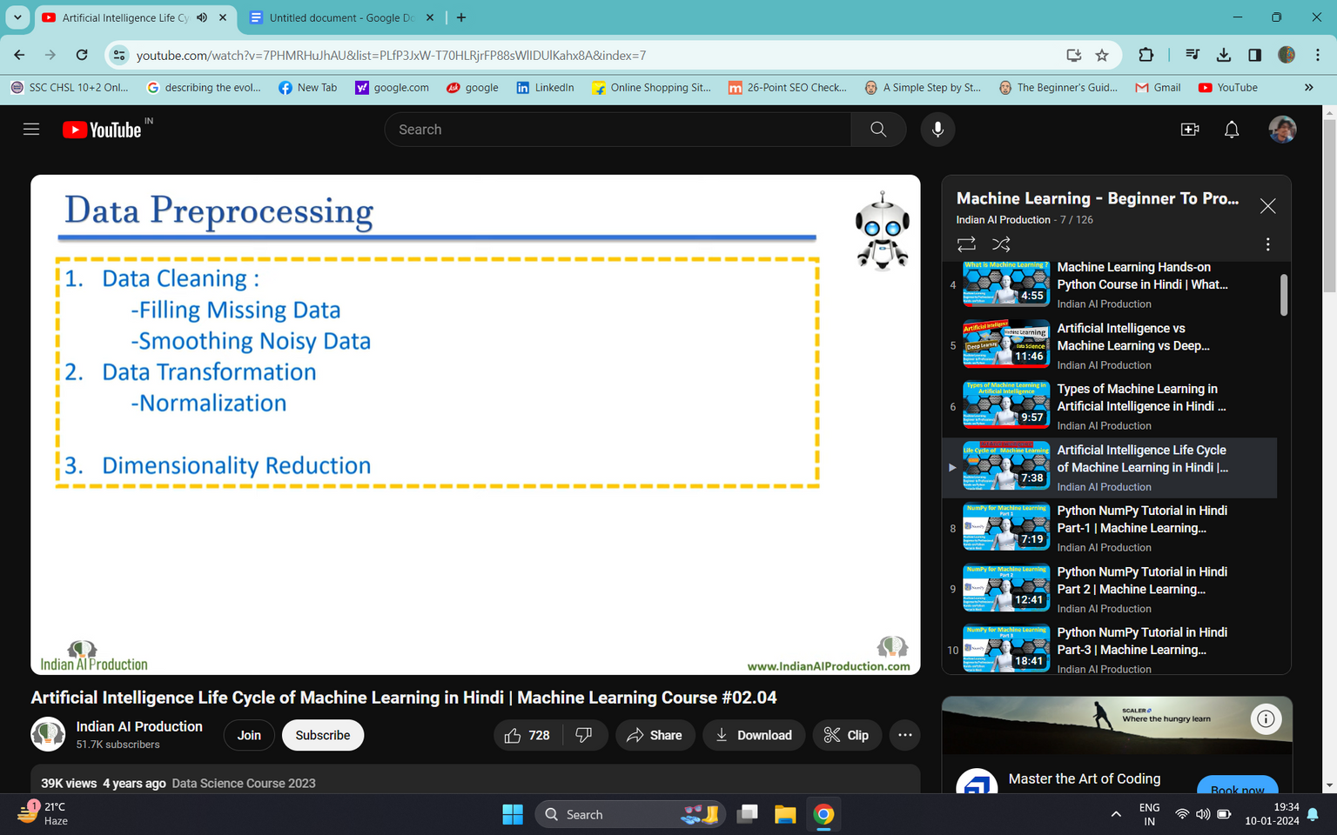
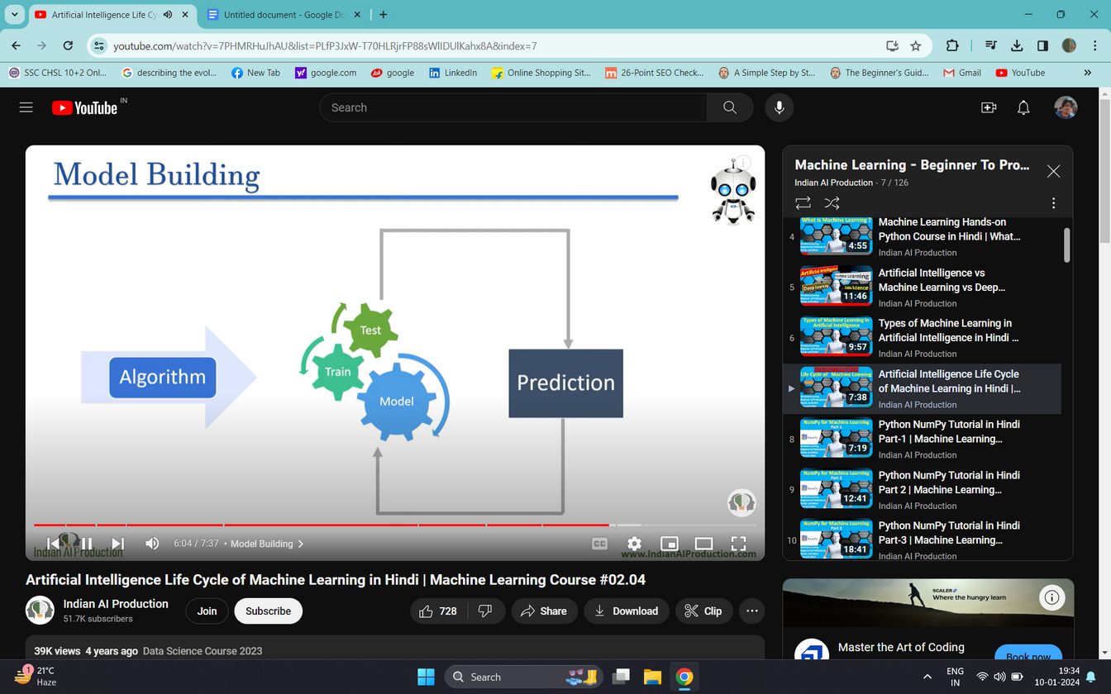
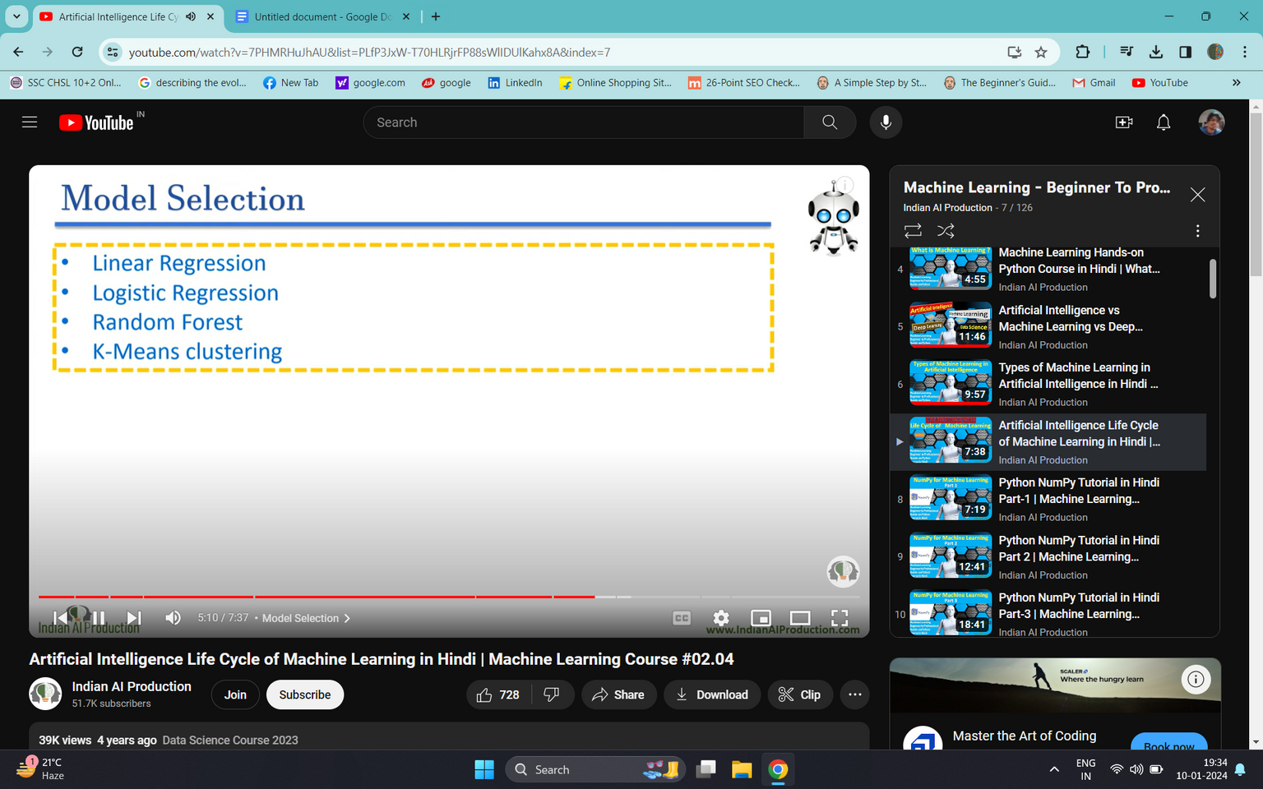
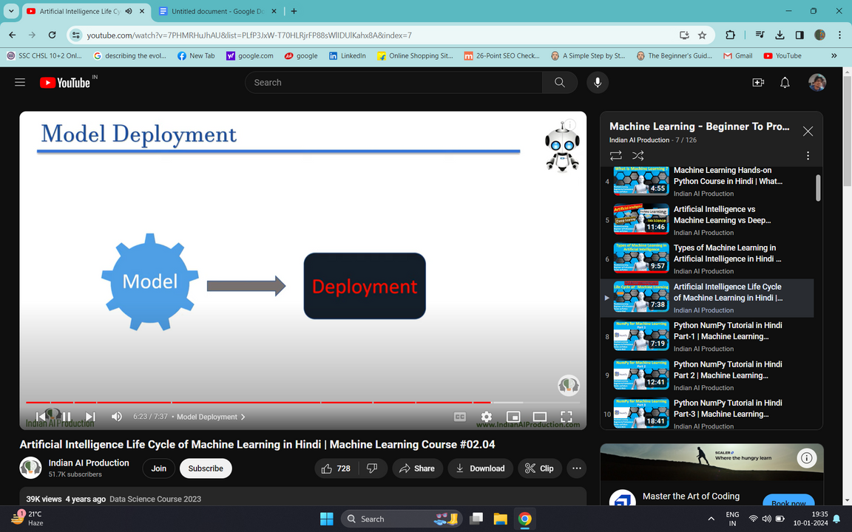

Slide 20


